Slide 1
Sphere of Influence (SOI) and Extra Territorial Jurisdiction
Washoe County Board of Adjustment
August 1, 2019

Slide 2
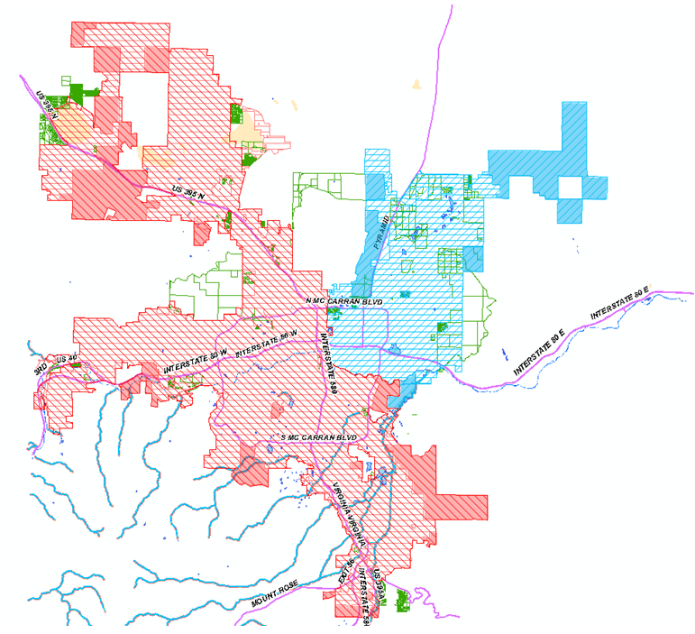
Sphere of Influence Map

Slide 3
Interlocal Agreements
City of Reno
  Signed January 28, 2003
City of Sparks
  Signed February 17, 2004
  The Cities of Reno and Sparks may exercise any power conferred pursuant to NRS 278.010 to NRS 278.630

Slide 4
Reno’s SOI
Reno’s Responsibilities
  Building Permits
  New Discretionary Applications
  WC Approved Discretionary Applications (Case by Case)
  Planning (Development/Municipal Code) Standards
Washoe County’s Responsibilities
  Business Licensing
  Code Enforcement

Slide 5
Sparks’ SOI
Sparks Responsibilities
  New Discretionary Applications
  Planning (Development/Municipal Code) Standards
Washoe County’s Responsibilities
  Building Permits
  WC Approved Discretionary Applications (Case by Case)
  Business Licensing
  Code Enforcement

Slide 6
SOI Problems/Challenges
Confusion of the residences
Confusion by staff, who provides the services?
Taxation without representation (still in WC, but controlled by the City)
Enforcing code enforcement and business license activities (inconsistency)
Provision of certain services are not specified in the interlocal agreements (i.e. boundary line adjustments, reversion to acreage, parcel maps, ministerial activities)

Slide 7
Areas Added or
Removed from SOI
From WC to City
  Utilize the County’s regulatory zoning, using translation table in Regional Plan.
  City must process a master plan amendment
From City to WC
  Utilize the City’s regulatory zoning and master plan land use using translation table in Regional Plan.
  Washoe County processes a master plan and regulatory zone amendment.

Slide 8
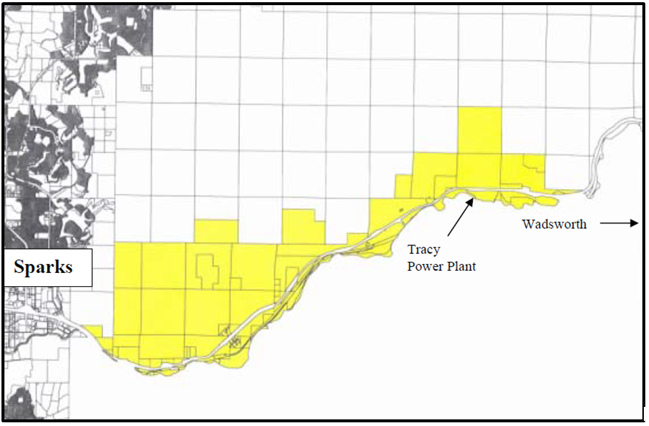
SOI Rollbacks

Slide 9
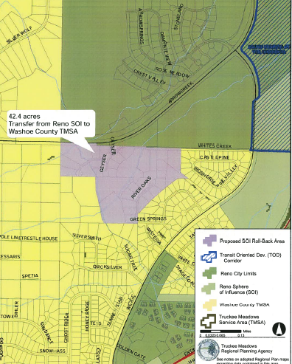
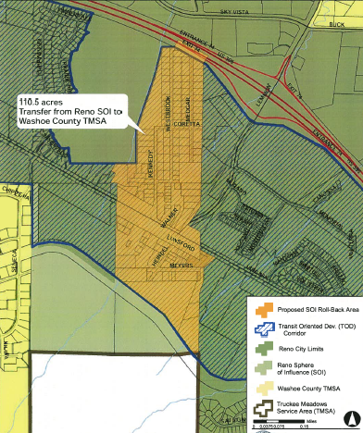
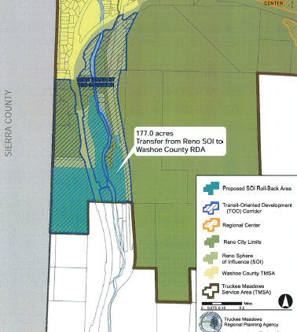
SOI Rollbacks

